Slide 1
Intro to HTML & CSS

Slide 2
Setup Checklist
Download Visual Studio Code + extensions
Download starter files from Github
Download Google Chrome (if you don’t already have it)

Slide 3
Goals and targets
Learn how to convert mockups to reality with HTML and CSS
Learn how to use Magento
Learn how to code responsively (mobile + desktop compatibility)

Slide 4
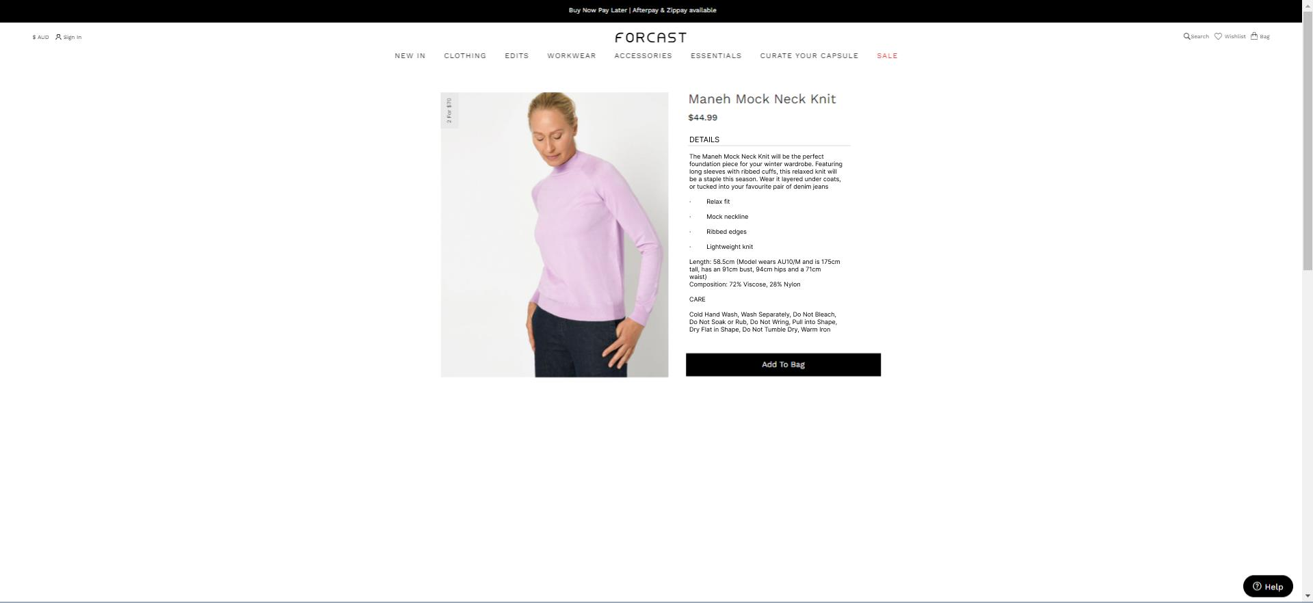
Goals and targets

Slide 5
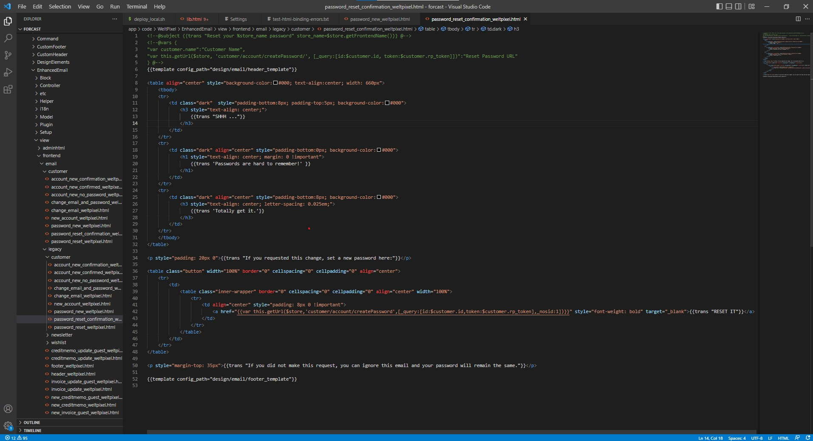
What’s Visual Studio Code?
Tabs
/Open files
Code editor
File explorer

Slide 6







What makes forcast.com.au?
{
Frontend
Backend
HTML
PHP
CSS
MySQL
Javascript
Browser
Server

Slide 7
What is HTML/CSS?
HTML = Hyper Text Markup Language
Use for page structure
Outlines the elements on a page. E.g., headings, images, links
CSS = Cascading Style Sheet
Used to control page design and layout
Colors, sizes fonts etc.

Slide 8
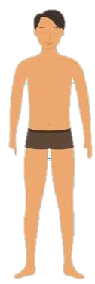
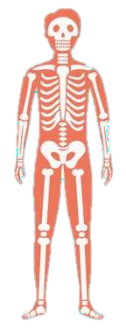
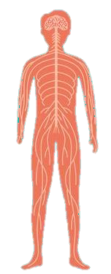
If a web page was like a person…
JavaScript
Logic
Control

Slide 9
If a web page was like a person…
CSS
HTML
Structure
JavaScript
Appearance
Size
Colour
Logic
Control

Slide 10
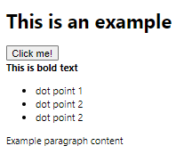
Intro to HTML
Consists of HTML elements defined by tags
These are the building blocks of web pages
<h1>This is an example</h1>
<button>Click me!</button>
<br />
<b>This is bold text</b>
<ul>
<li>dot point 1</li>
<li>dot point 2</li>
<li>dot point 2</li>
</ul>

Slide 11
HTML Element Tag Syntax
Start tag
End tag
Most of the time:
<p class="paragraph">Example paragraph content</p>
Attribute
Contents of tag
Sometimes:
<br />

Slide 12
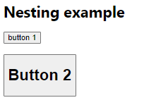
Nesting
HTML elements can contain other HTML elements
This is called nesting
<div class="container">
<h1>Nesting example</h1>
<button>button 1</button>
<br />
<br />
<button><h1>Button 2</h1></button>
</div>

Slide 13
Containers
All tags are containers
<div> is the most general-purpose container
<div>
<div>
<h1>Heading!</h1>
<p>Paragraph!</p>
<div>
</div>

Slide 14
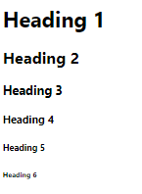
Headings
There are 6 heading tags, varied by size
<h1> - <h6>
<h1>Heading | 1</h1>
<h2>Heading | 2</h2>
<h3>Heading | 3</h3>
<h4>Heading | 4</h4>
<h5>Heading | 5</h5>
<h6>Heading | 6</h6>

Slide 15

Paragraphs
Headings are usually (not always) followed by paragraph tags
<p>
<p>This is a paragraph about absolutely nothing.</p>

Slide 16

Images
The image tag displays an image given a url
<img>
<img src="https://www.google.com.au/images/ branding/googlelogo/1x/googlelogo_colo r_272x92dp.png"/>

Slide 17

Lists
There are two types of list tags, ordered and unordered
<ul>, <ol>
<ul>
<li>list item</li>
<li>list item</li>
<li>list item</li>
</ul>
<ol>
<li>list item</li>
<li>list item</li>
<li>list item</li>
</ol>

Slide 18
Links
Links are used for redirecting a user to another page
<a>
<a href="https://www.google.com.au">Click here!</a>

Slide 19
Inputs
Inputs are for when you want to capture data from user
There are many different types view them here
<input>
<button>Click me</button>
<input type="button" value="Click
me"></input>
<input type="date"></input>
<input type="file"/>

Slide 20
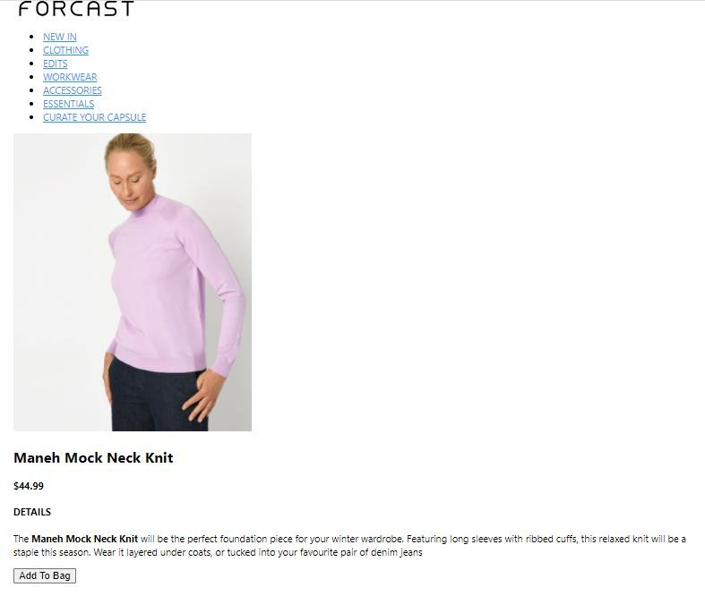
Activity: Forcast’s new PDP Part 1

